Slide 1


2D Visualization with the ArcGIS API for JavaScript
Kristian Ekenes
Jeremy Bartley
2019 ESRI DEVELOPER SUMMIT
Palm Springs, CA
Notes:
G243257 DevSummit 2019 Template for Esri staff

Slide 2
API Overview
Renderers, Symbols, etc.

Slide 3
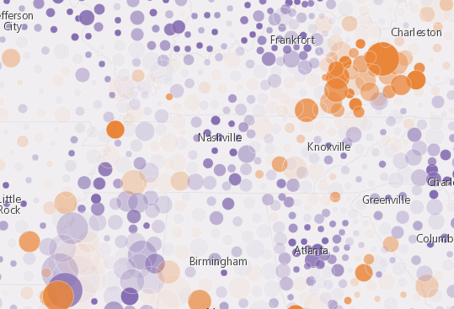
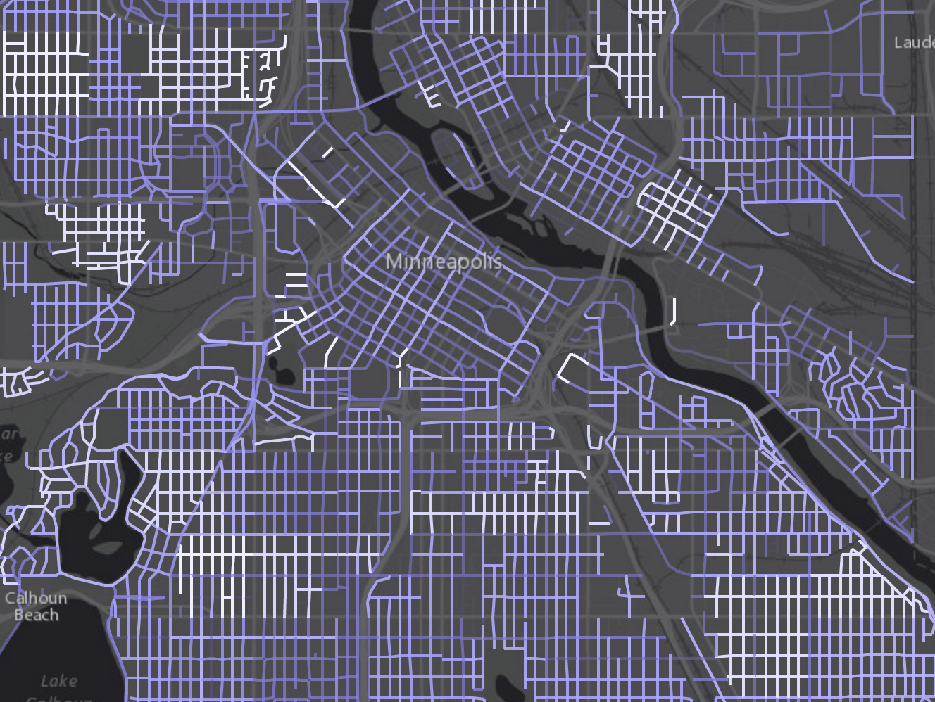
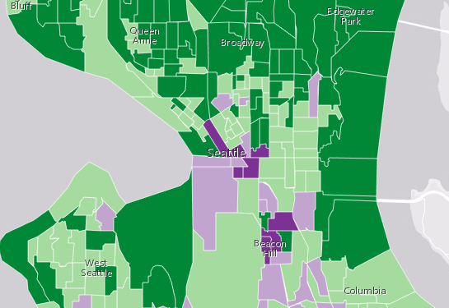
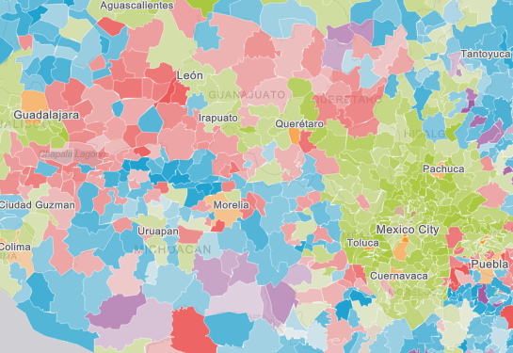
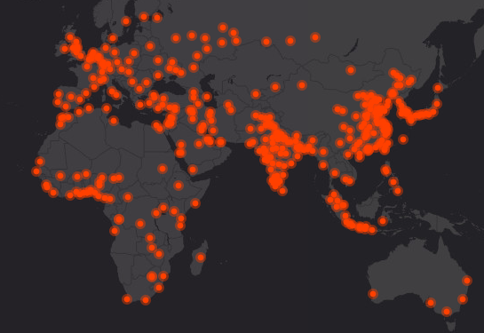
What can we visualize?
Where?
What?
How much?
When?
Multivariate

Slide 4
Symbols

Slide 5

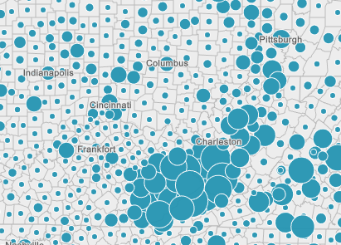
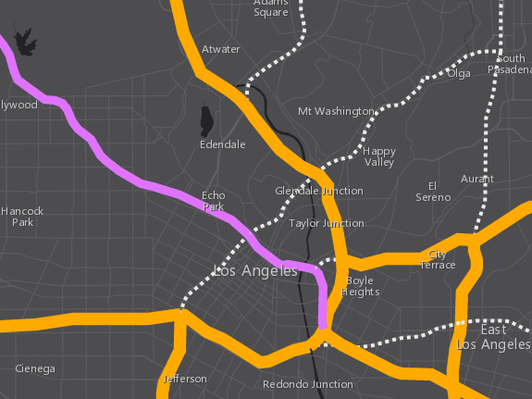
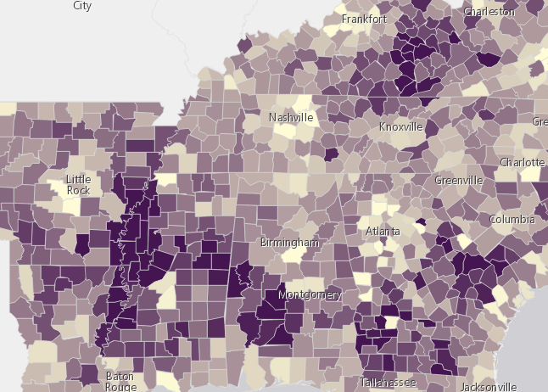
Symbols
based on geometry type
Points
Lines
Polygons
SimpleMarkerSymbol
SimpleFillSymbol
SimpleLineSymbol
PictureFillSymbol
PictureMarkerSymbol
SimpleMarkerSymbol
PictureMarkerSymbol

Slide 6
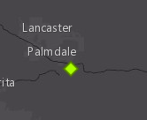
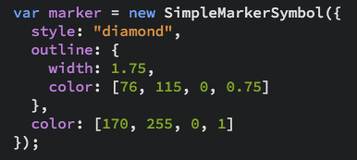
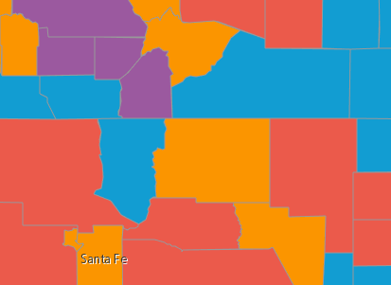
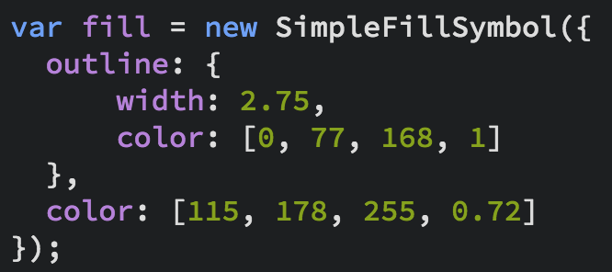
Symbols
Notes:
Show the playground here

Slide 7
Data
FeatureLayer
FeatureCollection
MapImageLayer
CSVLayer
StreamLayer
GeoJSONLayer

Slide 8
Data-driven visualization
Field value(s)
TOTAL_POP
Arcade expression
Round( ($feature.BACHELOR + $feature.MASTER) / $feature.POP_25UP) );

Slide 9
Renderers

Slide 10
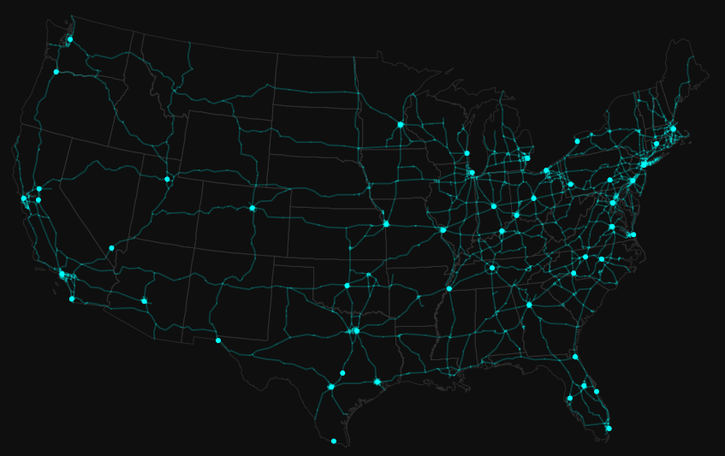
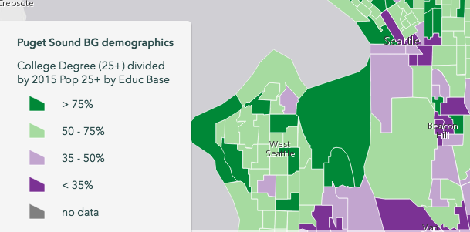
UniqueValueRenderer
Renderers
SimpleRenderer
ClassBreaksRenderer

Slide 11
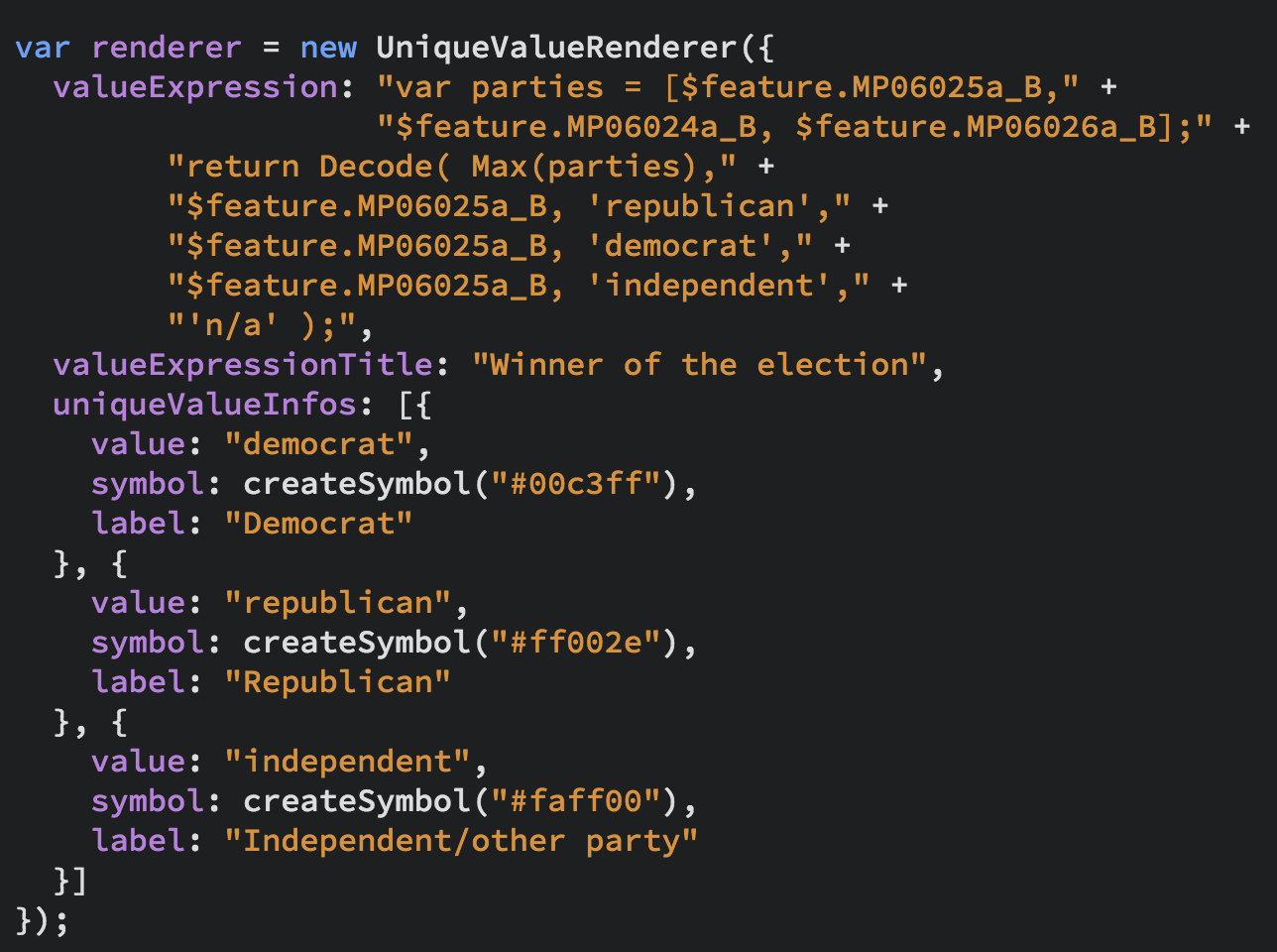
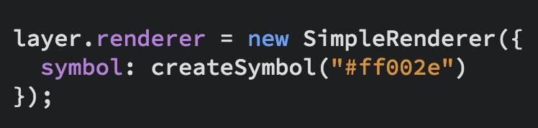
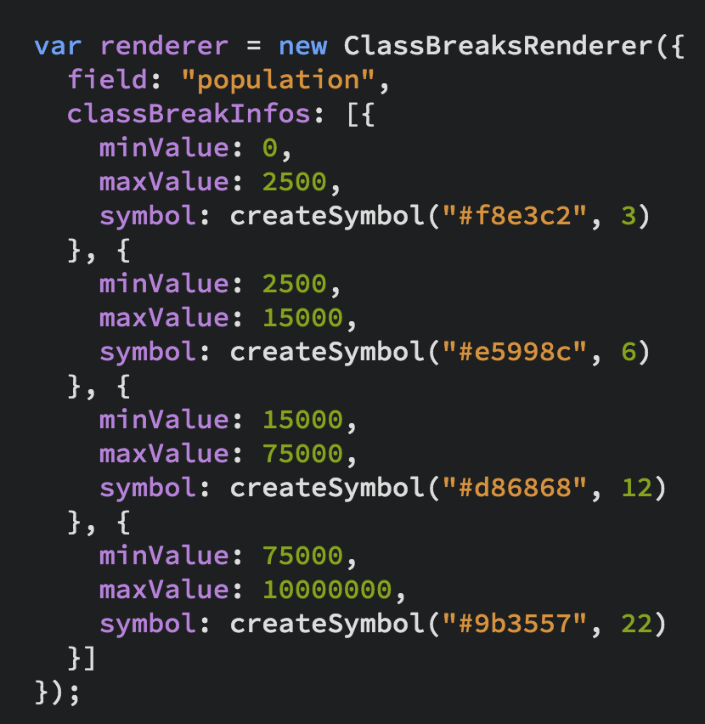
UniqueValueRenderer
Renderers
SimpleRenderer
ClassBreaksRenderer

Slide 12
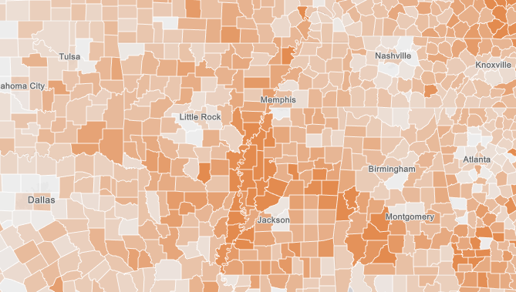
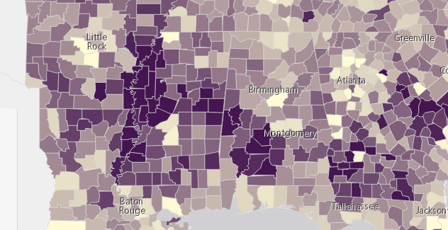
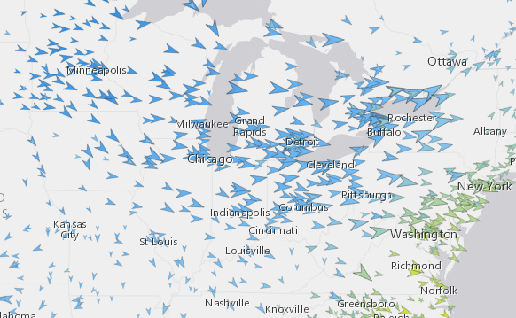
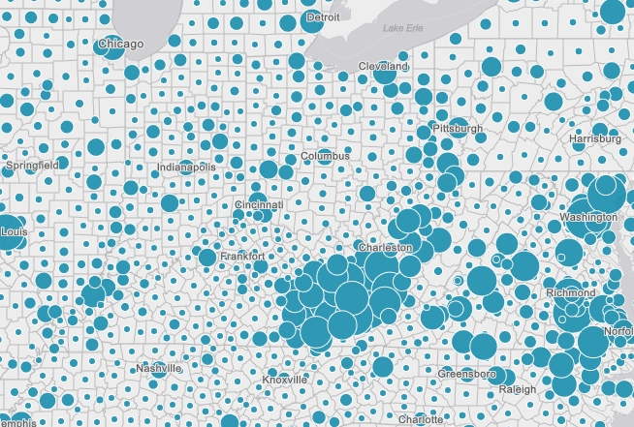
Renderers
Visual Variables
A property of the renderer
For numeric data-driven continuous visualizations
Color
Size
Opacity
Rotation

Slide 13
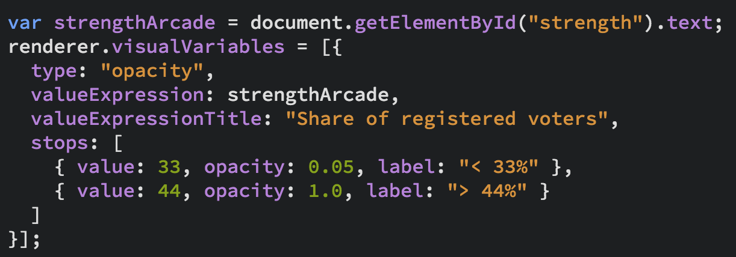
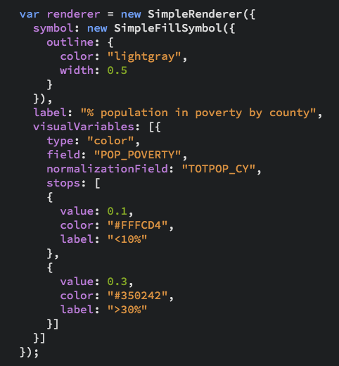
Renderers
Visual Variables

Slide 14


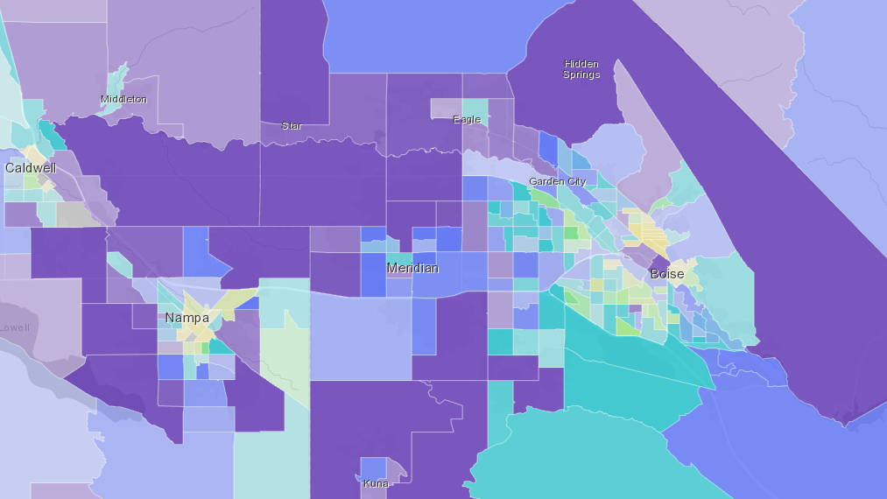
Examples
SimpleRenderer, UniqueValueRenderer, Predominance, Arcade Expressions

Slide 15

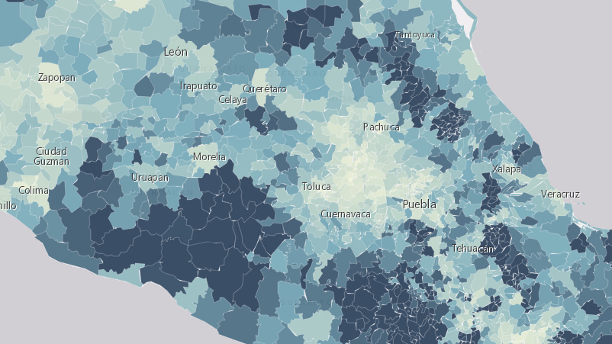
Visual Variables
Earthquakes, housing, elections, Smart Mapping

Slide 16
Smart Mapping

Slide 18
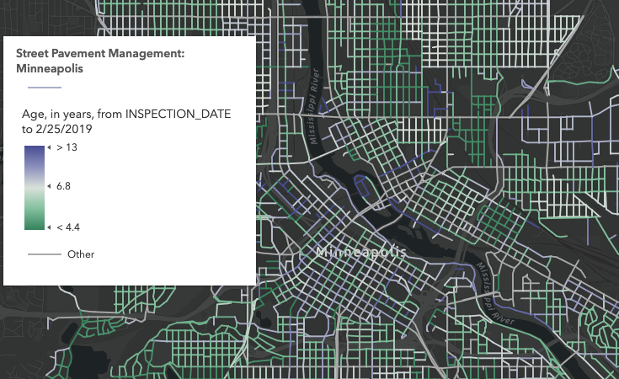
Age

Slide 19
Predominance

Slide 20
Relationship

Slide 21
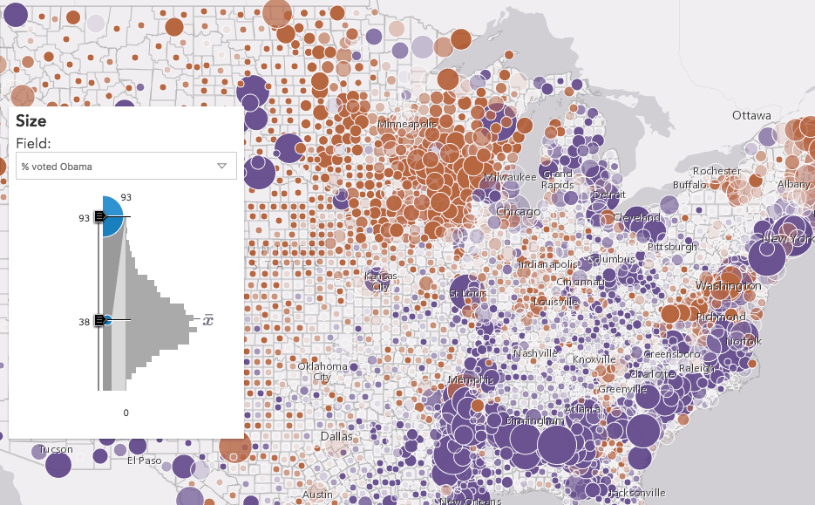
Data Exploration
Smart Mapping

Slide 22
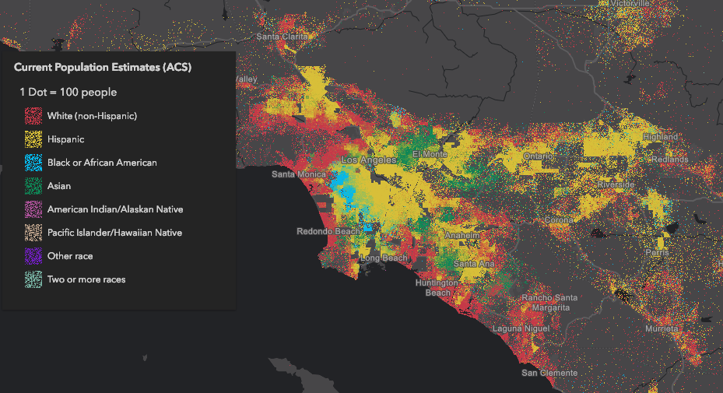
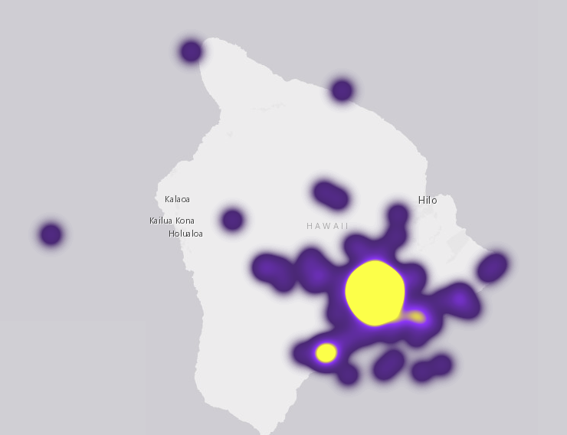
More Renderers
DotDensityRenderer
HeatmapRenderer
New since DevSummit 2018!

Slide 23
FeatureLayer updates
More data can be displayed.
MaxRecordCount factor by tile
pbf queries reduce payload size
Reduced feature duplication
Faster drawing (first draw and final draw)

Slide 24
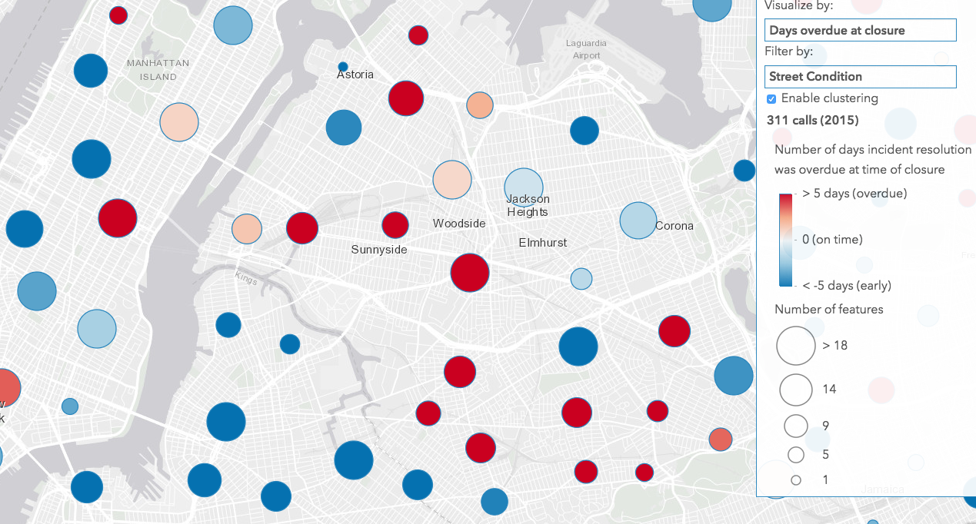
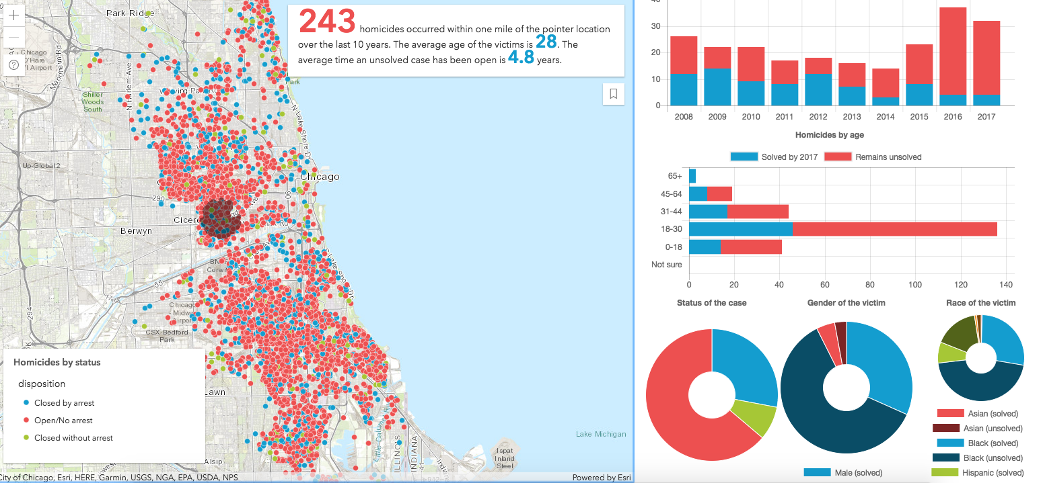
Visualize lots of data
Heatmap
Clustering
Display all of it!

Slide 25
Client-side processing
Client-side queries, Fast visual variable updates, Clustering, Heatmap
Notes:
https://maps.esri.com/jg/Covenants/index.html
https://maps.esri.com/jg/HawaiiEarthquakeAnalysis/index.html
https://developers.arcgis.com/javascript/latest/sample-code/featurelayerview-query-distance/live/index.html
https://developers.arcgis.com/javascript/latest/sample-code/visualization-heatmap/live/index.html
https://developers.arcgis.com/javascript/latest/sample-code/visualization-heatmap-scale/live/index.html

Slide 26
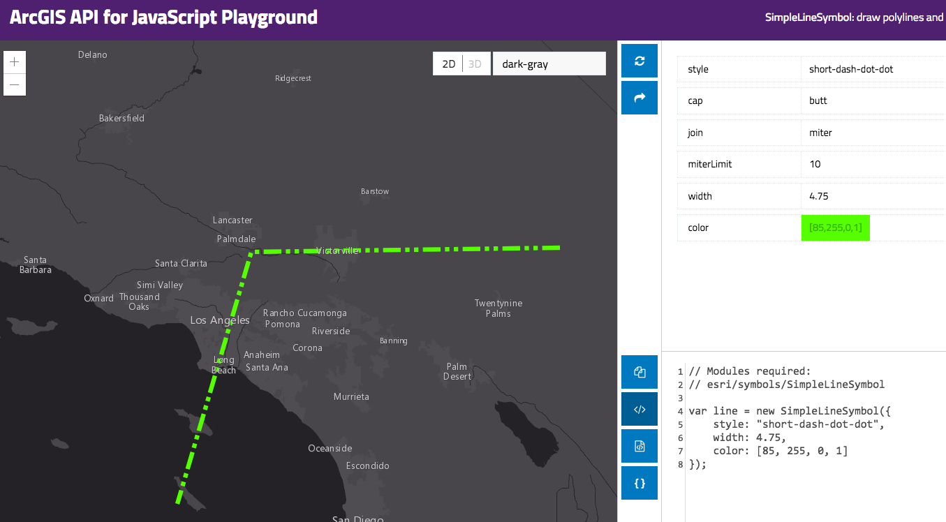
Resources
Get started with visualization
ArcGIS Blog
Visualization Samples
Documentation
Renderer
Symbol

Slide 27


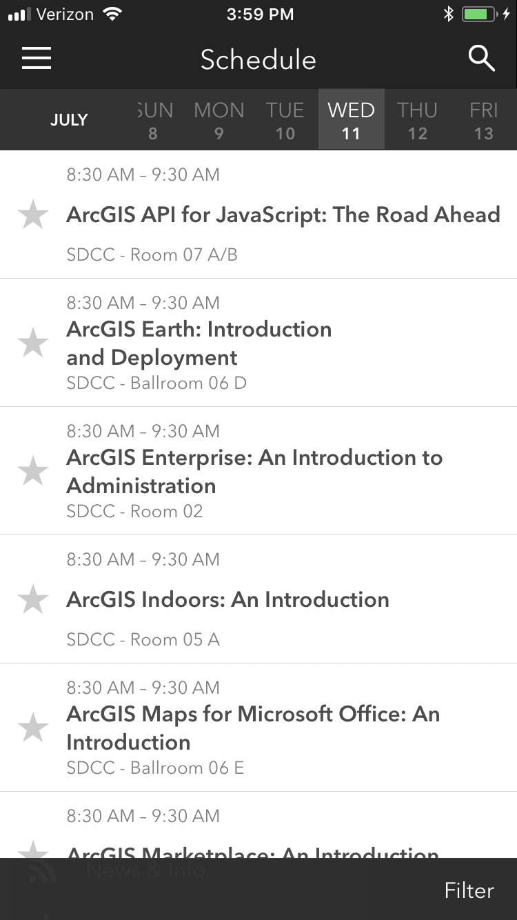
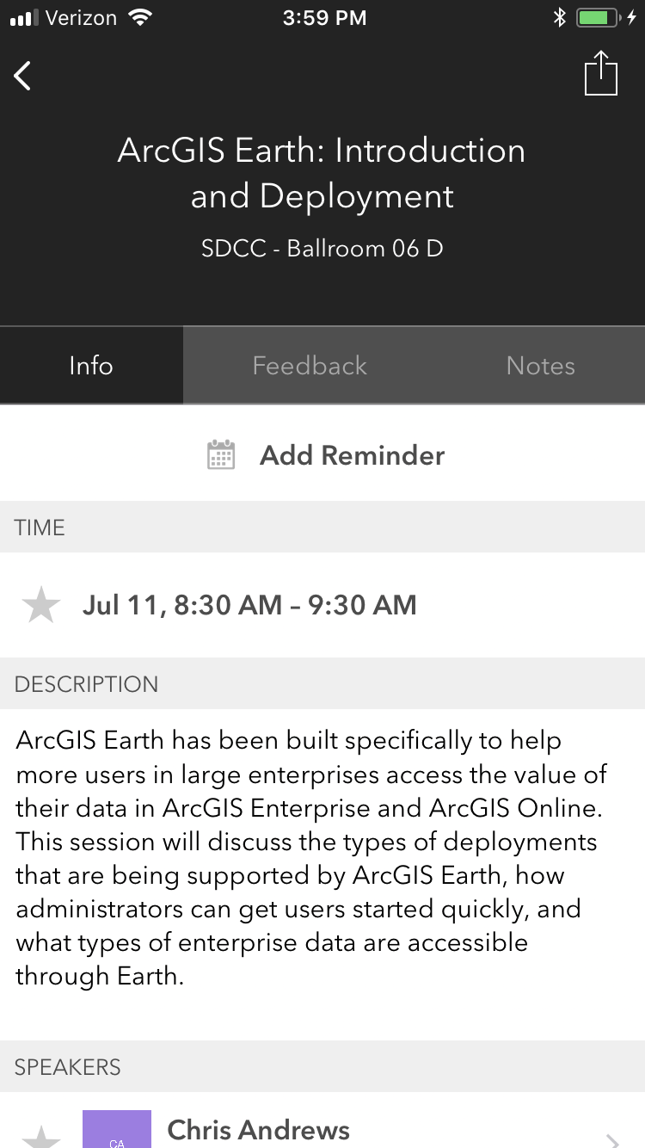
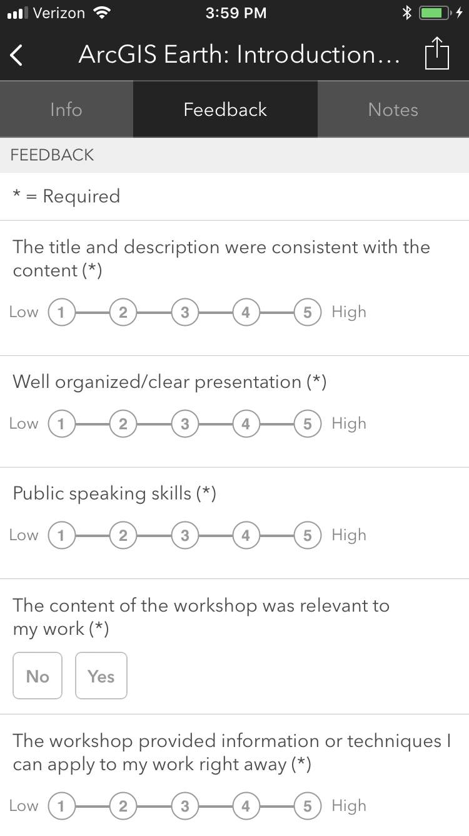
Please Take Our Survey on the App
Download the Esri Events app and find your event
Select the session you attended
Scroll down to find the feedback section
Complete answers
and select “Submit”

Slide 28


